Slide 1

AI Pipeline for Image Segmentation & Analysis
Presented by Chandradithya Janaswami

Slide 2



Objective of this Project
Develop a pipeline to segment, identify, and analyze objects in an image, with a summary table of mapped data.

Slide 3


01.
Image Segmentation
02.
Object Extraction
Key Components of this Project
03.
Object Identitfication
04.
Text Identification and extraction
05.
Summarization
06.
Data Mapping

Slide 4

Approach summary
The AI pipeline developed for image segmentation and object analysis is designed to process input images through a series of modular steps, ensuring a comprehensive analysis of each object within the image.
Image Segmentation: Utilizing the YOLOv8 segmentation model, objects within the image are segmented and saved as individual images with unique IDs, ensuring each object can be tracked and analyzed separately.
Object Detection: The segmented objects are further analyzed using YOLOv8's object detection capabilities, identifying and classifying each object with confidence scores.
Text Extraction: EasyOCR is employed to extract any text present within the segmented objects, enabling the identification of textual data for further analysis.
Summarization: A summarization module compiles the detected objects' attributes, including descriptions and text, into concise summaries for each object.
Each step of the pipeline is modular, allowing for easy integration, testing, and adaptation to different use cases. The final output includes a visual representation of the segmented objects and a detailed summary table mapping all relevant data.

Slide 5


Project Development Process
DAY 01
DAY 02
DAY 03
DAY 04
I carefully researched and selected the models best suited for the project, including advanced pre-trained models like YOLO for object detection and Transformers for image analysis.
I began by developing the individual models required for the project, leveraging pre-trained models such as YOLO and Transformers to accelerate implementation and improve accuracy.
After coding the individual components, I focused on integrating these models into a cohesive pipeline, ensuring seamless interaction and functionality across the project.
I conducted thorough final code corrections and rigorous testing to validate the pipeline’s performance, ensuring that all components functioned correctly and met the project requirements.

Slide 6

Streamlit UI Implementation
File Upload: Users can upload input images.
Segmentation Display: Shows segmented objects on the original image.
Object Details: Displays object images with IDs, descriptions, extracted text/data, and summaries.
Final Output: Shows annotated final image and summary table.

Slide 7
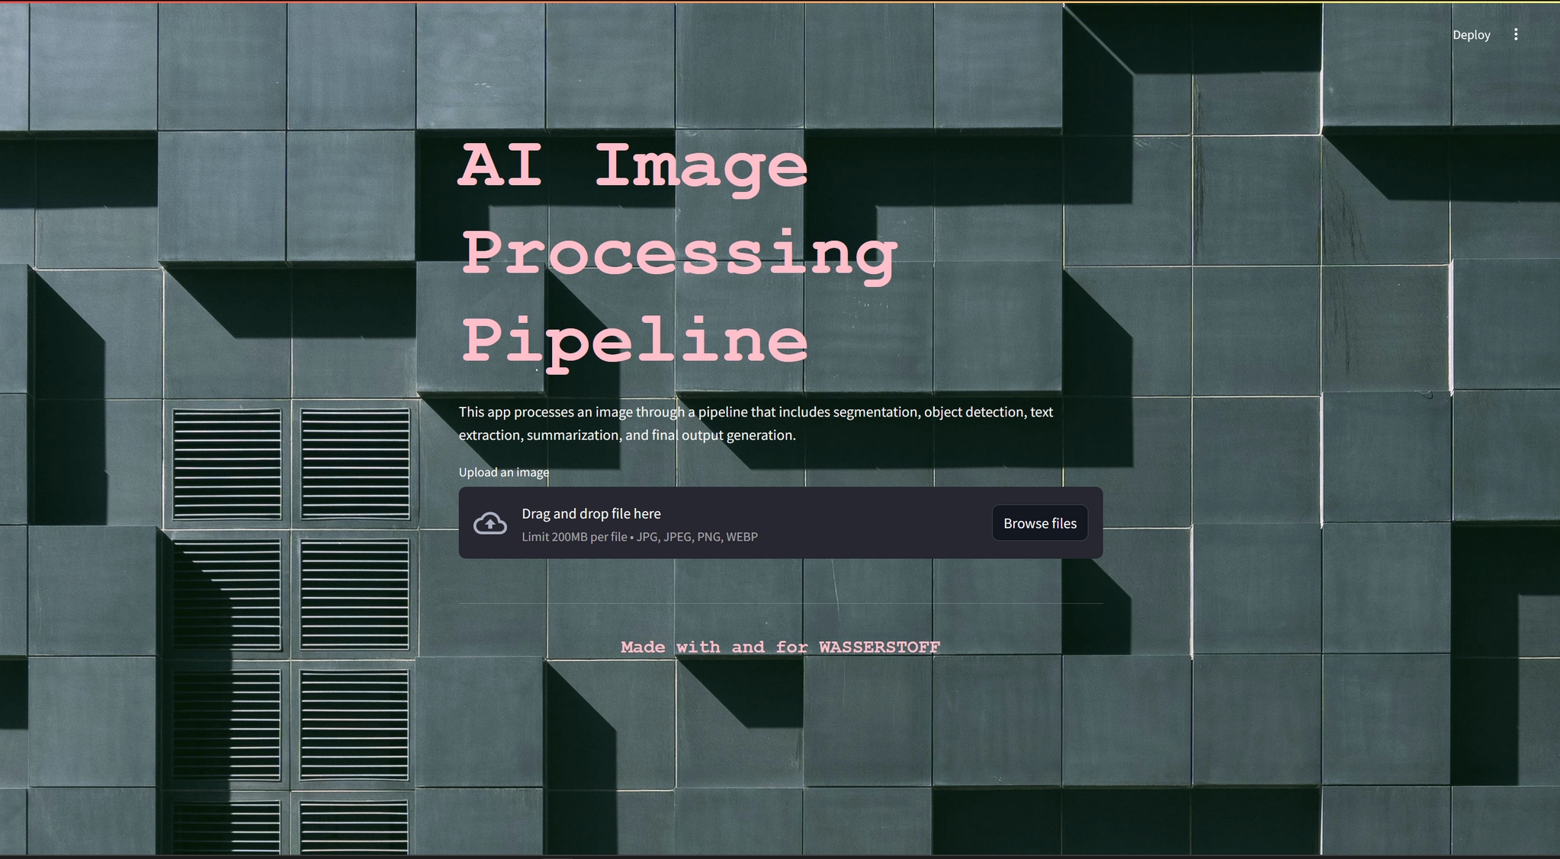

Slide 8






34 / 40
Success cases

Slide 9
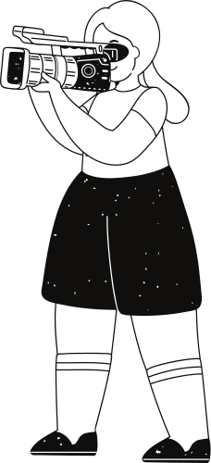
Weaknesses
Threats
Incomplete Test Coverage: 6 test cases failed, indicating potential issues or gaps in the pipeline that need addressing.
Integration Complexity: Complex integration of multiple models and components may lead to challenges in maintaining and debugging.
Model Limitations: Pre-trained models may have inherent limitations or biases that could affect performance.
Scalability Issues: As the pipeline scales to handle larger datasets or more complex tasks, performance or integration issues may arise.
Strengths
Opportunities
Advanced Models: Utilized state-of-the-art pre-trained models like YOLO and Transformers for accurate image segmentation and object identification.
Modular Design: Developed a well-structured pipeline with modular components, ensuring flexibility and ease of integration.
Model Improvement: Opportunity to fine-tune models and improve accuracy, especially in areas where test cases failed.
Enhanced Features: Potential to add new features or improve existing ones, such as better data visualization or additional object analysis capabilities.

Slide 10
Thank you very much!
https://wassertoff.streamlit.app/

